Slide 1
APPETIZER

Slide 2
Parts of Computer Hardware
Input
Devices
STORAGE DEVICES
(Hard Disk, CD Drive, DVD Drive, Floppy Drive etc.)
BUS
Microprocessor
Extended Slots
Power
Supply
BUS
Ports
Output
Devices
BUS
BUS
BUS
Memory Unit (RAM, ROM, Cache)

Slide 3
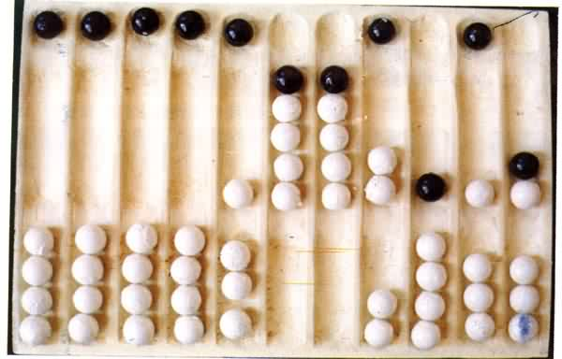
Year : 300 B.C
ABACUS

Slide 4
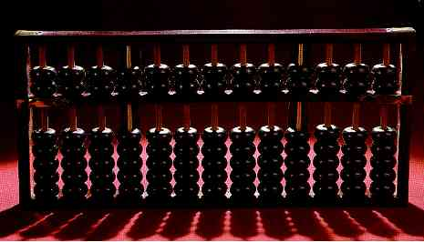
Modern Abacus
Note how the abacus is really just a representation of the human fingers: the 5 lower rings on each rod represent the 5 fingers and the 2 upper rings represent the 2 hands.

Slide 5
Year : 1617 A.D
Logarithms:
John Napier invented logarithms, which
are a technology that allows multiplication
to be performed via addition.

Slide 6
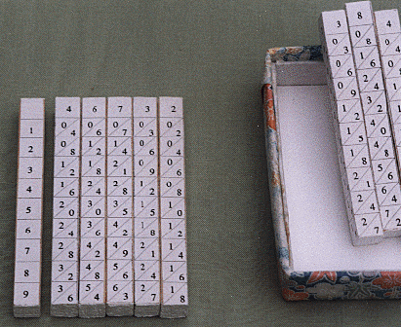
Napier’s Bones
The logarithm of each operand was originally obtained from a printed table, but Napier bones were alternative to tables, where the logarithm values were carved on ivory sticks .

Slide 7
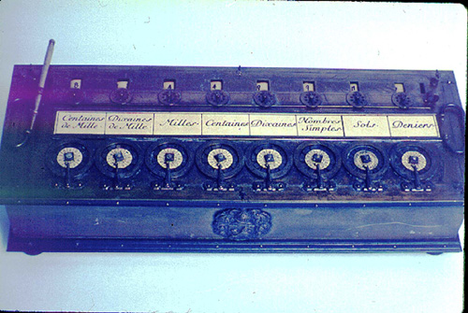
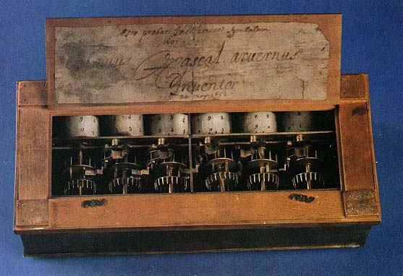
Year : 1642 A.D
Blaise Pascal, at age 19, invented the Pascaline as an aid for his father who was a tax collector.
Up until the present age when car dashboards went digital, the odometer portion of a car's speedometer used the very same mechanism as the Pascaline to increment the next wheel after each full revolution of the prior wheel.

Slide 8

Just a few years after Pascal, the German Gottfried Wilhelm
Leibniz (co-inventor with Newton of calculus) managed to build a
four-function (addition, subtraction, multiplication, and division)
calculator that he called the stepped reckoner because, instead
of gears, it employed fluted drums having ten flutes arranged
around their circumference in a stair-step fashion.
Although the stepped reckoner employed the decimal number
system (each drum had 10 flutes), Leibniz was the first to
advocate use of the binary number system which is fundamental
to the operation of modern computers. Leibniz is considered one
of the greatest of the philosophers but he died poor and alone.

Slide 9
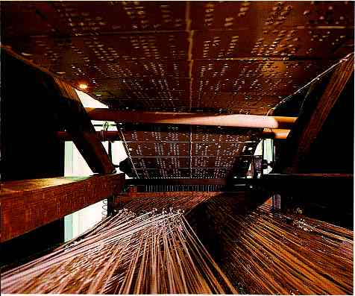
Year: 1801 A.D (Punch Cards)
The Frenchman Joseph Marie
Jacquard invented a power
loom that could base its weave
(and hence the design on the
fabric) upon a pattern
automatically read from
punched wooden cards, held
together in a long row by rope.

Slide 10
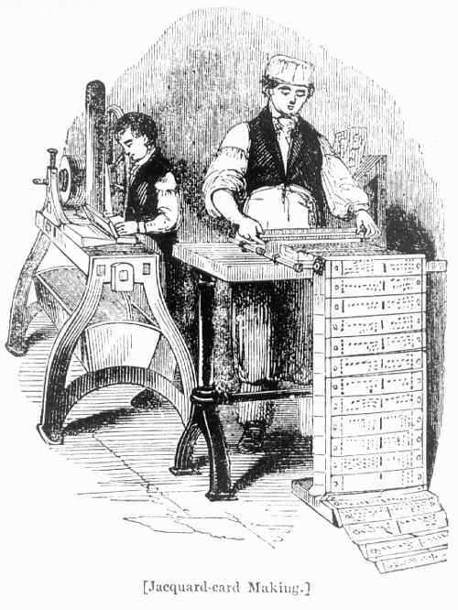
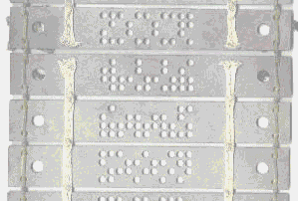
Punch card or Jacquard card
A closer look

Slide 11
Year : 1822 A.D
The English mathematician Charles Babbage was proposing a steam driven calculating machine the size of a room, which he called the Difference Engine. This machine would be able to compute tables of numbers, such as logarithm tables.

Slide 12
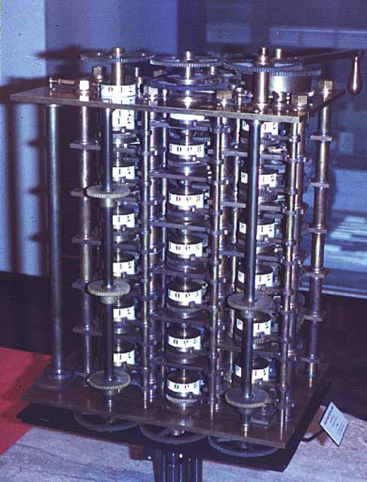
The Difference Engine
A small section of the type of mechanism employed in Babbage's Difference Engine [photo © 2002 IEEE]

Slide 13
Analytical Engine
This device, large as a house and powered by 6 steam engines, would be more general purpose in nature because it would be programmable, thanks to the punched card technology of Jacquard.
In the Jacquard loom, the presence or absence of each hole in the card physically allows a colored thread to pass or stops that thread (you can see this clearly in the earlier photo). Babbage saw that the pattern of holes could be used to represent an abstract idea such as a problem statement or the raw data required for that problem's solution. Babbage saw that there was no requirement that the problem matter itself physically pass thru the holes.

Slide 14
Analytical engine (ctd...)
Furthermore, Babbage realized that punched paper could be employed as a storage mechanism, holding computed numbers for future reference. Because of the connection to the Jacquard loom, Babbage called the two main parts of his Analytic Engine the "Store" and the "Mill", as both terms are used in the weaving industry. The Store was where numbers were held and the Mill was where they were "woven" into new results. In a modern computer these same parts are called the memory unit and the central processing unit (CPU).

Slide 15
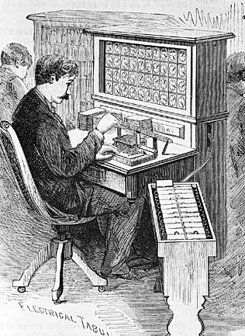
Year : 1890 A.D
Herman Hollerith's invention, known as the Hollerith desk, consisted of a card reader which sensed the holes in the cards, a gear driven mechanism which could count (using Pascal's mechanism which we still see in car odometers), and a large wall of dial indicators (a car speedometer is a dial indicator) to display the results of the count.

Slide 16
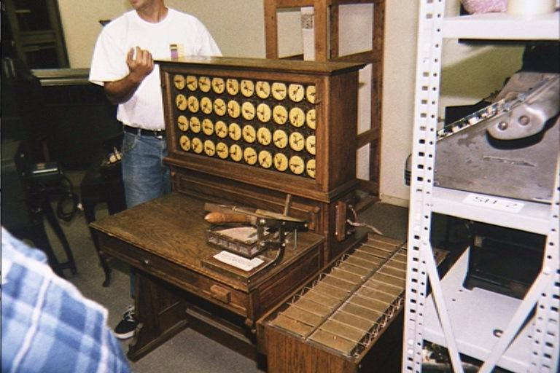
Hollerith desks still exist today

Slide 17
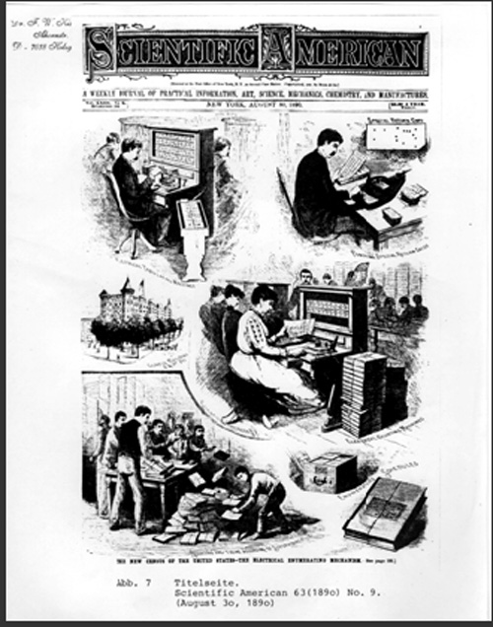
Hollerith and IBM
Incidentally, the Hollerith census machine was the first machine to ever be featured on a magazine cover.
Hollerith built a company, the Tabulating Machine Company which, after a few buyouts, eventually became International Business Machines, known today as IBM. IBM grew rapidly and punched cards became ubiquitous.

Slide 18
More about IBM
IBM continued to develop mechanical calculators for sale to businesses to help with financial accounting and inventory accounting.
One early success was the Harvard Mark I computer which was built as a partnership between Harvard and IBM

Slide 19
First Generation - 1940-1956
Major Innovation – Vacuum Tube
The first computers used vacuum tubes and were often enormous, taking up entire rooms.
They were very expensive to operate and in addition to using a great deal of electricity, generated a lot of heat, which was often the cause of malfunctions.
The UNIVAC and ENIAC computers are examples of first-generation computing devices.

Slide 20
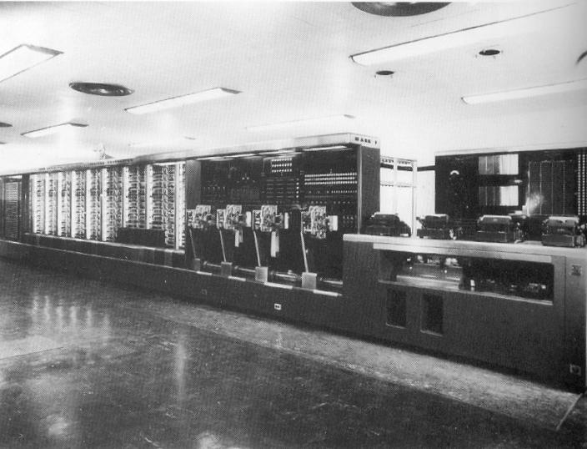
Mark 1

Slide 21
Mark 1
This was the first programmable digital computer made in the U.S.
It was not a purely electronic computer. Instead the Mark I was constructed out of switches, relays, rotating shafts, and clutches.
The machine weighed 5 tons, incorporated 500 miles of wire, was 8 feet tall and 51 feet long, and had a 50 ft rotating shaft running its length, turned by a 5 horsepower electric motor.
The Mark I ran non-stop for 15 years, sounding like a roomful of ladies knitting.

Slide 22
History of ‘Bug’
One of the primary programmers for the Mark I was a woman, Grace Hopper.
Hopper found the first computer "bug": a dead moth that had gotten into the Mark I and whose wings were blocking the reading of the holes in the paper tape.
The word "bug" had been used to describe a defect since at least 1889 but Hopper is credited with coining the word "debugging" to describe the work to eliminate program faults.

Slide 23
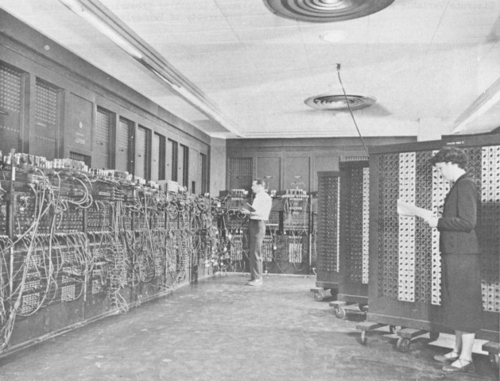
Year : 1943 – 1945
The first electronic digital computer ENIAC (Electronic Numerical Integrator and Calculator)
ENIAC was built by two professors, John Mauchly and J. Presper Eckert at the University of Pennsylvania

Slide 24
Second Generation - 1956-1963:
Major Innovation – Transistor
The transistor was far superior to the vacuum tube, allowing computers to become smaller, faster, cheaper, more energy-efficient and more reliable than their first-generation predecessors.
Though the transistor still generated a great deal of heat that subjected the computer to damage, it was a vast improvement over the vacuum tube. Second-generation computers still relied on punched cards for input and printouts for output.
The first computers of this generation were developed for the atomic energy industry.

Slide 25
Third Generation - 1964-1971
Major Innovation – Integrated Circuits / IC
The development of the Integrated Circuits was the hallmark of the third generation of computers.
Transistors were miniaturized and placed on semi conductor chips, called IC, which drastically increased the speed and efficiency of computers.
Instead of punched cards and printouts, users interacted with third generation computers through keyboards and monitors and interfaced with an operating system
Computers for the first time became accessible to a mass audience because they were smaller and cheaper than their predecessors

Slide 26
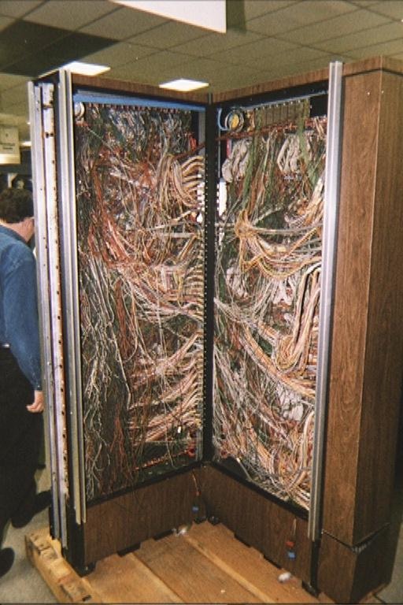
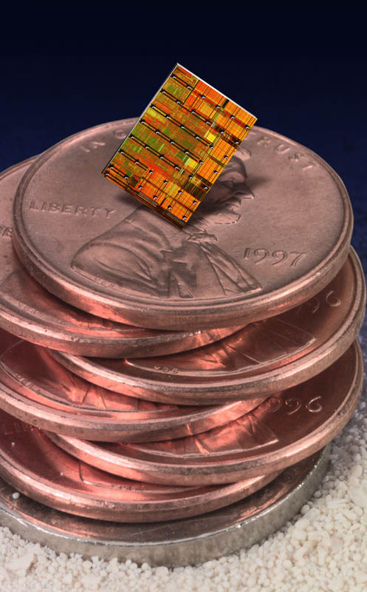
Revolution of IC

Slide 27
Fourth Generation - 1971-Present
Major Innovation – Microprocessor
Microprocessor is defined as thousands of integrated circuits were built onto a single silicon chip.
In 1981 IBM introduced its first computer for the home user
In 1984 Apple introduced the Macintosh.
As these small computers became more powerful, they could be linked together to form networks, which eventually led to the development of the Internet.

Slide 28
Fifth Generation - Present and Beyond
Major Innovation – Artificial Intelligence
Computers with intelligence like a human being
  Robotics
  Speech and Voice Recognition
  Image and Thumb recognition
  Simulation
  Virtual Reality
  Expert Systems
  Etc.

Slide 29
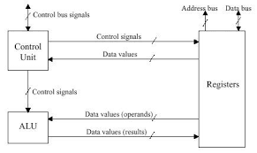
The Microprocessor
A combination of integrated circuit that contains all the functions of a central processing unit of a computer.

Slide 30
Parts of Microprocessor
Control Unit
  A control unit or CU is circuitry that directs operations within a computer's processor. It lets the computer's logic unit, memory, as well as both input and output devices know how to respond to instructions received from a program.
Arithmetic & Logical Unit
  An arithmetic logic unit (ALU) is a digital circuit used to perform arithmetic and logic operations. It represents the fundamental building block of the central processing unit (CPU) of a computer.
Memory Unit / Registers

Slide 31
Registers
A processor register (CPU register) is one of a small set of data holding places that are part of the computer processor.
A Program Counter / Instruction register hold an instruction
An Address register holds memory addresses
An Accumulator / Data register hold results of frequent calculations within microprocessor

Slide 32
Memory
Computer memory is any physical device capable of storing information by computer
Volatile memory is computer memory that requires power to maintain the stored information. (e.g. RAM, Cache, Register)
Non-volatile memory is computer memory that can retain the stored information even when not powered. (e.g. ROM, CMOS)

Slide 33
RAM
Random-access memory is the most common type of memory that stores data and applications currently being used or in execution by computer system. Most modern semiconductor volatile memory is either Static RAM or Dynamic RAM.
DRAM, or Dynamic RAM, is the most widely used RAM that consumers deal with. DDR3 is an example of DRAM. It needs to be refreshed periodically when in use,
SRAM does not need to be refreshed by microprocessor.

Slide 34
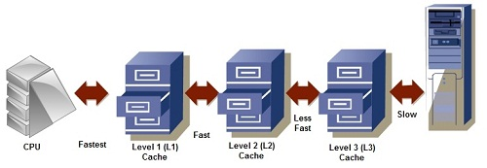
Cache Memory
The cache memory lies in the path between the processor and the memory. So, it is very near to the CPU and also called CPU memory, all the Recent Instructions are Stored into the Cache Memory.

Slide 35
Cache Memory Types
L1 cache, or primary cache, is extremely fast but relatively small, and is usually embedded in the processor chip as CPU cache.
L2 cache, or secondary cache, is larger than L1. L2 cache may be embedded on the CPU, or it can be on a separate chip.
Level 3 (L3) cache is specialized memory developed to improve the performance of L1 and L2. Also called as external cache.

Slide 36
ROM and Types
ROM stands for Read Only Memory. The memory from which we can only read but cannot write on it. This type of memory is non-volatile. The information is stored permanently in such memories during manufacture. A ROM stores such instructions that are required to start a computer.
PROM (programmable ROM) is a one - time user-programmable memory.
EPROM (erasable programmable ROM) was invented to allow making changes in the contents of PROM after it is burned.

Slide 37
ROM and Types
EEPROM (Electrically erasable PROM) does not require the entire contents of ROM are erased. However, the main advantage of EEPROM is that one can program and erase its contents while it is still in the system board. it does not require physical removal of the memory chip from its socket. In other words, unlike UV-EPROM, EEPROM does not require an external erasure and programming device.
4. Flash memory is used to store flexible boot instructions. It allows erasure of the entire contents takes less than a second, or one might say in a flash, hence its name, Flash memory.

Slide 38
CMOS
CMOS is short for complementary metal-oxide semiconductor.
CMOS is an on-board, battery powered semiconductor chip inside computers.
CMOS generally stores date/time or BIOS passwords information.

Slide 39
Computer Bus
A bus is a subsystem that is used to connect computer components and transfer data between them.
A System Bus connects microprocessor with RAM while, the control bus a set of connections among the parts in the computer.
The data bus acts as a channel for data from the keyboard, memory and other devices. It passes information at speeds up to billions of characters per second.
The computer must be able to access every character of memory rapidly, so every character has its own address number. The address bus carries such memory addresses.

